Slide 1
DMIT 1530
Week 1
Photoshop Refresher

Slide 2
Photoshop is a massive application that can be used for many things; however, we will only be going over the tools we need to dissect a provided wireframe.

Slide 3
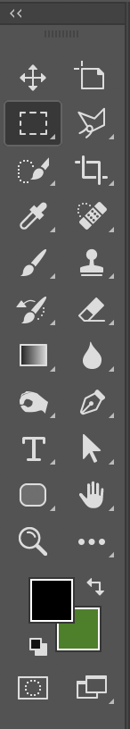

Navigation
Zoom Tool [ Z ]
Zoom in or out of the document (depending upon which mode is selected in the control bar).
Navigator Panel
Can be found under Window > Navigator, or by using the search feature.

Slide 4
Navigation (Keyboard Shortcuts)
Zoom In
CTRL + [ + ] | ⌘ + [ + ]
Zoom Out
CTRL + [ – ] | ⌘ + [ – ]
Fit To Window
CTRL + [ 0 ] | ⌘ + [ 0 ]

Slide 5
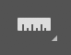
Colours & Information
Eyedropper Tool [ I ]
Allows you to sample colours. Double-click on the foreground colour (in your tools) to grab the hex code.
Ruler Tool [ I ]
Allows you to measure the distance between elements. Make sure to hold SHIFT so that you are not measuring at an angle (as this will make the distance longer).

Slide 6
Workspace Rulers & Guides
Workspace Rulers
Can be toggled with CTRL + [ R ] | ⌘ + [ R ].
Units can be changed by right-clicking on the ruler.
Guides
Non-printing lines that give your Ruler Tool points to snap to. To create a guide, click and drag from a workspace ruler.
Can be toggled with CTRL + [ ; ] | ⌘ + [ ; ].

Slide 7
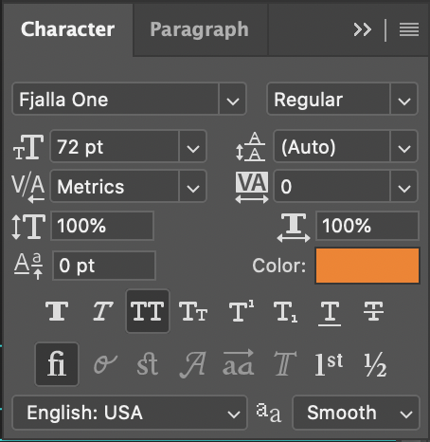
Type Tool [ T ]
Clicking a text layer with the Type Tool allows you to copy the content and paste it into your text editor.
Selecting a text layer also allows you to see the text’s properties in the control bar.
For more in-depth properties, use the Character Panel (Window > Character).

Slide 8
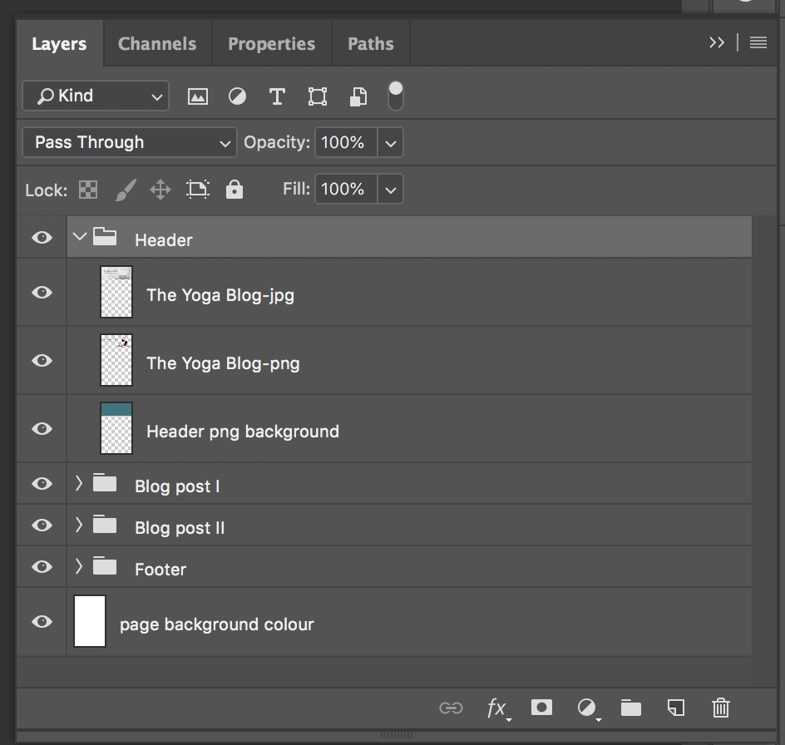
Layers Panel
Layers on the top of the stack are in the front of the image; layers on the bottom of the stack are in the back of the image.
Layers can be hidden and unhidden by clicking the eye icon to the left of the layer.

Slide 9
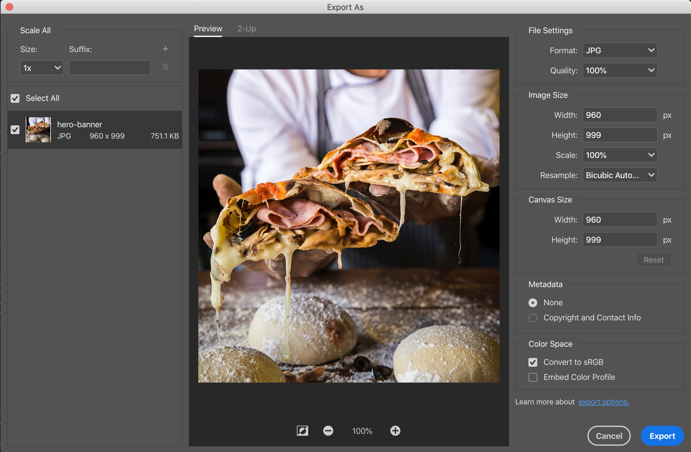
Saving Images
i. Find the layer with the image in the Layers Panel.
ii. Right click on the layer and choose ‘Export As …’
iii. Double-check your image settings. Using a semantic filename, export the image to your img folder.

